Slide 1

SUPERVISED BY
Dr. S. MANOHAR B.Sc (Computer Science), M.Sc(cs), M.E (CSE), PHD (CSE)
PRESENTED BY
1. K.SIDDARTH PATEL (VTU28319)(24UECS1237)
2. RAMSETTY SREEVASTHAV (VTU28844)(24UECS1353)
3. A.RAKESH (VTU27728)(24UECS1121)
BATCH NO: DEPARTMENT OF COMPUTER SCIENCE & ENGINEERING

Slide 2
Hostel Complaint Management System
AGENDA
Introduction
Literature Survey
Problem Statement
Proposed Methodology
Proposed System Architecture
Implementation Plan/Timeline

Slide 3
Introduction
Manual complaint handling causes delays.
Students cannot easily track complaint status.
Complaints may be misplaced or overlapped.
There is no centralized complaint management system.
Assigning complaints to staff is difficult.
Emergency complaints may not receive quick attention.
Hostel administrators face difficulty in managing multiple complaints.
Complaint resolution time is difficult to monitor.
Generating complaint reports manually is time-consuming.
A digital system is needed for efficient and transparent complaint management.
Problem Statement:

Slide 4
Introduction
Project Goal :
To develop a centralized hostel complaint management system.
To allow students to submit complaints easily.
To provide real-time complaint status tracking.
To help wardens manage and assign complaints efficiently.
To reduce complaint resolution time.
To provide notifications for complaint updates.
To maintain organized complaint records.
To improve communication between students and hostel staff.
To generate reports for better management.
To provide a transparent and efficient complaint resolution process.

Slide 5
Introduction
Brief Overview:
Traditional hostel complaint management is often handled through registers, verbal communication, or manual forms. These methods can cause delays, difficulty in tracking complaints, and poor communication between students and hostel administrators. Students may also have limited information about the progress of their complaints.
A digital Hostel Complaint Management System provides a centralized platform for submitting, tracking, assigning, and resolving complaints. It helps wardens manage complaints efficiently, maintain complaint records, send status updates, and generate reports. This improves transparency, reduces response time, and provides better service to hostel students.

Slide 6
Literature Survey
Existing Systems and Related Works:
Existing hostel systems commonly use manual complaint registers and complaint boxes, which make tracking and maintaining complaint records difficult.
Web-based complaint management systems allow students to register complaints online and enable administrators to monitor and update their status.
Ticket-based models provide a unique complaint ID, helping students track the progress of their complaints from registration to resolution.
Role-based systems provide separate access for students, wardens, and maintenance staff, making complaint assignment and management more organized.

Slide 7
Problem Statement
Limitations of Existing Solutions
Manual processes can cause delays in complaint resolution.
Students may not get real-time updates on complaint status.
Complaint assignment and priority management can be inefficient.
Existing systems may have limited reporting and feedback features.

Slide 8
Proposed Methodology
User Registration & Login – Provide secure login for students, wardens, and staff.
Complaint Registration – Students can submit complaints with relevant details.
Complaint Categorization – Classify complaints into electrical, plumbing, food, cleanliness, etc.
Priority Assignment – Assign priority based on the urgency of the complaint.
Staff Assignment – Warden assigns complaints to the appropriate maintenance staff.
Complaint Tracking – Track complaints from submission to resolution.
Notifications – Send updates to students whenever the complaint status changes.
Feedback System – Allow students to provide feedback after resolution.
Reports & Analytics – Generate reports to monitor complaints and improve hostel services.

Slide 9
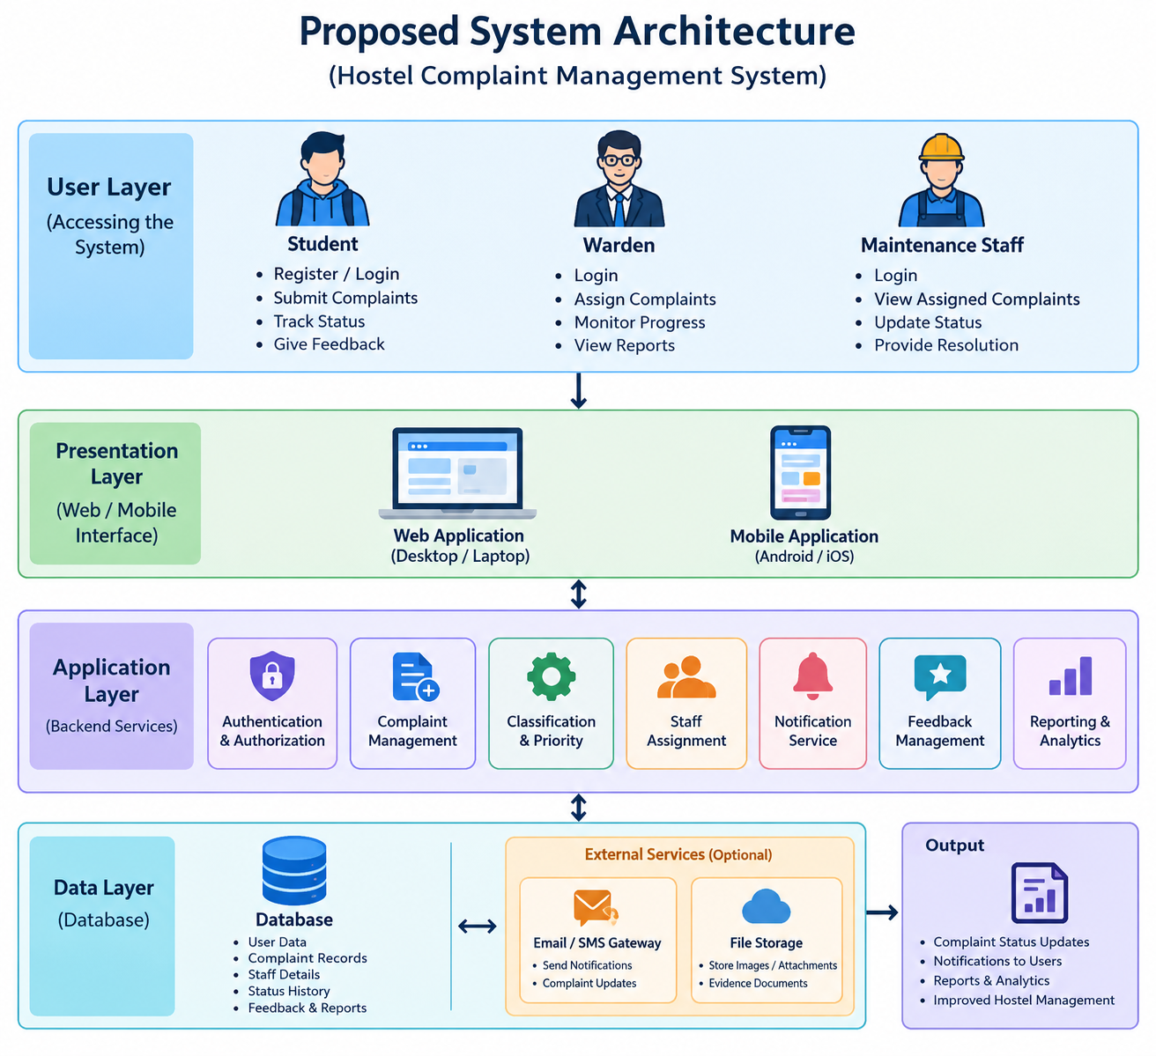
Proposed System Architecture

Slide 10
Summary of Module -1
Provides an overall view of all hostel complaints.
Displays total, pending, assigned, in-progress, and resolved complaints.
Shows complaint statistics based on category and priority.
Helps wardens monitor complaint resolution performance.
Provides reports and insights for improving hostel maintenance.
Maintains complaint history for future reference.

Slide 11
Software & Hardware Requirements Specification
Software Requirements
Operating System: Windows 10/11 or Linux
Frontend: HTML, CSS, JavaScript / React.js
Backend: Node.js and Express.js
Database: MySQL / MongoDB
Development Tool: Visual Studio Code
Browser: Google Chrome / Microsoft Edge
Version Control: Git and GitHub

Slide 12
Hardware Requirements:
Processor: Intel Core i3 or above
RAM: Minimum 4 GB, recommended 8 GB
Storage: Minimum 20 GB free space
Display: 1366 × 768 resolution or higher
Input Devices: Keyboard and Mouse
Network: Wi-Fi or Ethernet connection
Server: Minimum 4 GB RAM with sufficient storage

Slide 13
Implementation Plan/Timeline
Key Milestones:
Week 1-2:Requirement analysis, problem identification, literature survey, and system design.
Week 3-4: UI/UX design, database design, and frontend development.
Week 5-6:Backend development, complaint management, user authentication, and database integration.
Week 7-8: System testing, bug fixing, deployment, documentation, and final presentation.

Slide 14
THANK YOU

